Slide 1
Project Title: IoT (Internet of Things)-aided smart Global Donor Egg Program.
Presented By: Ekta Chavan

Slide 2
Problem:
In an egg Donation System the donor has to undergo unnecessary medication to get her hormonal cycle to be in synchronization with the receiver.
Health Hazards that have long-term effects
Exhaustive existing process that takes longer time for donor and recipient matching

Slide 3
Solution:
This project comes up with an appropriate and innovative solution using IOT Device.
The basal body temperature of the donors and recipients is taken through the device which pre determine the Hormonal records.
Hence no extra meds to be taken and saves time.

Slide 4
Key Features:
Timely recording of Basal Body Temperatures
IOT device simulation
Complete track of all the records of donors as well as recipients under one Admin

Slide 5
Special Features
Automatic Hormonal records generation
Statistics of Hormonal records can be viewed by the donor and the recipient

Slide 6
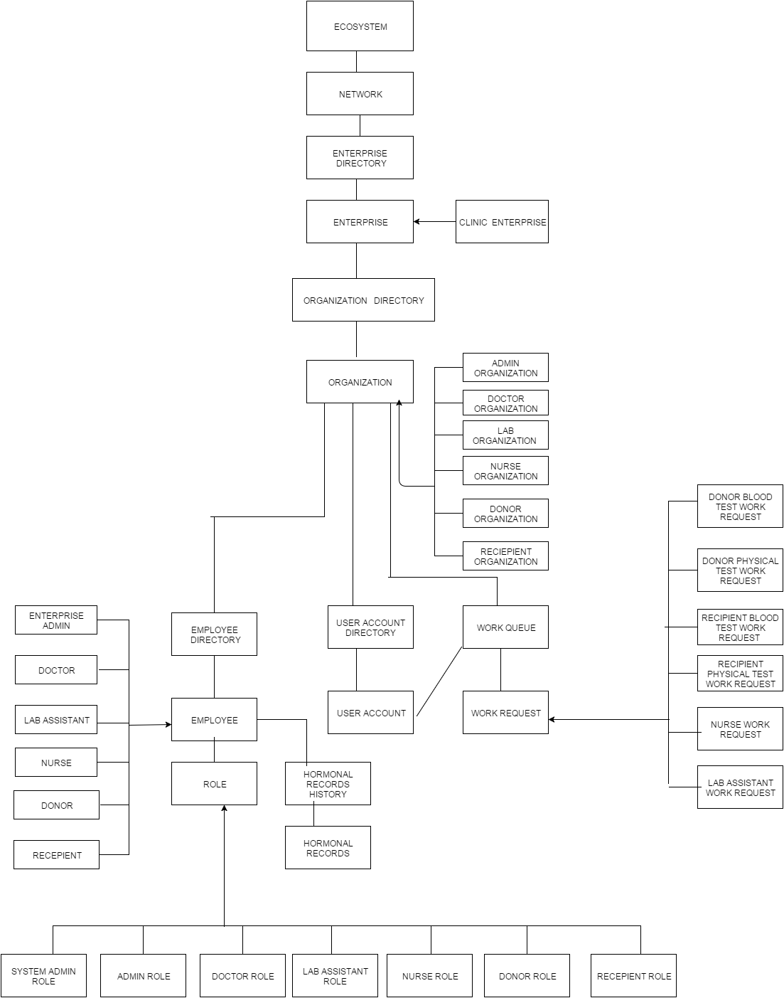
Object Model:

Slide 7
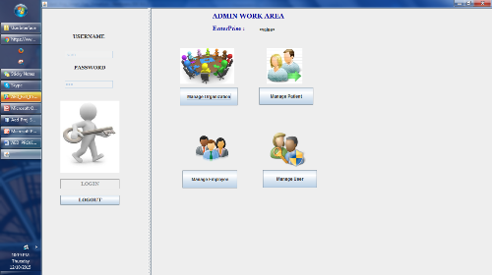
Admin Work Area:

Slide 8
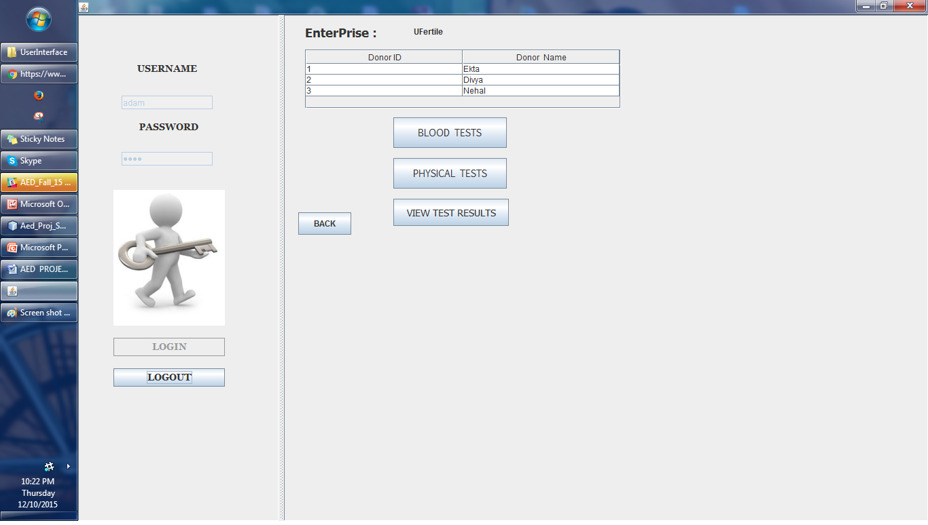
Doctor Requests Job

Slide 9
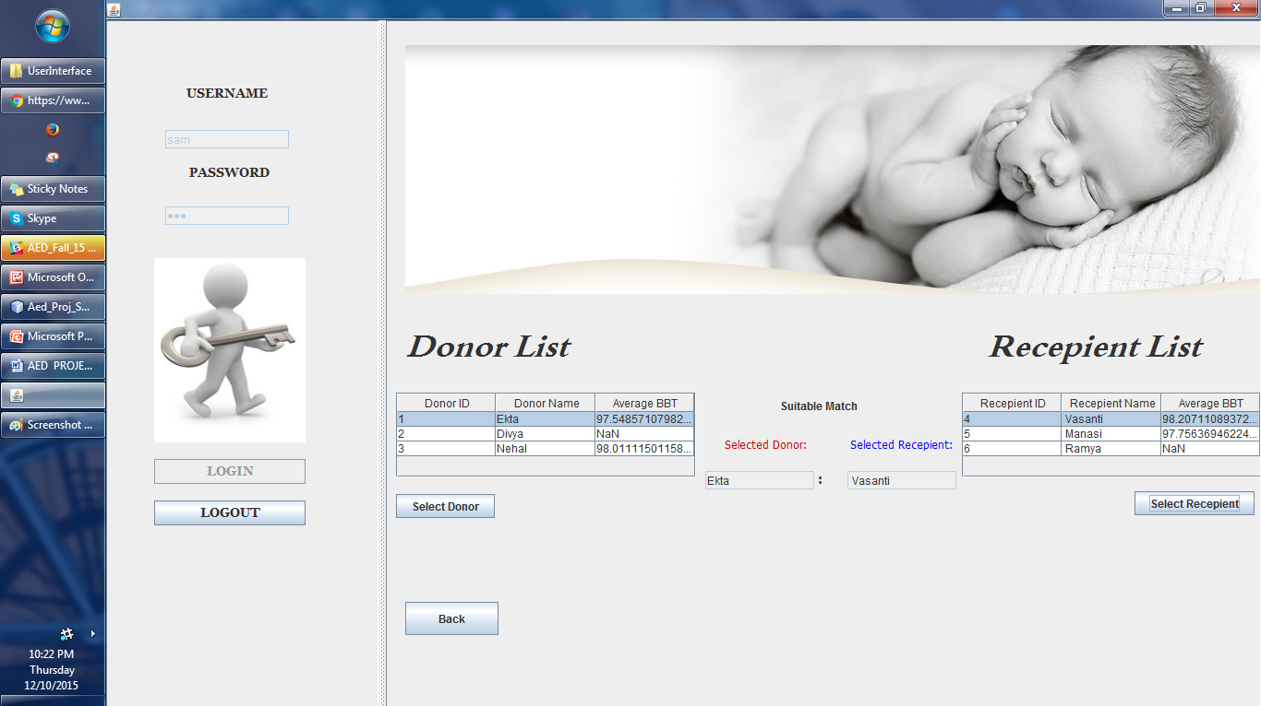
Admin Views Data for matching

Slide 10
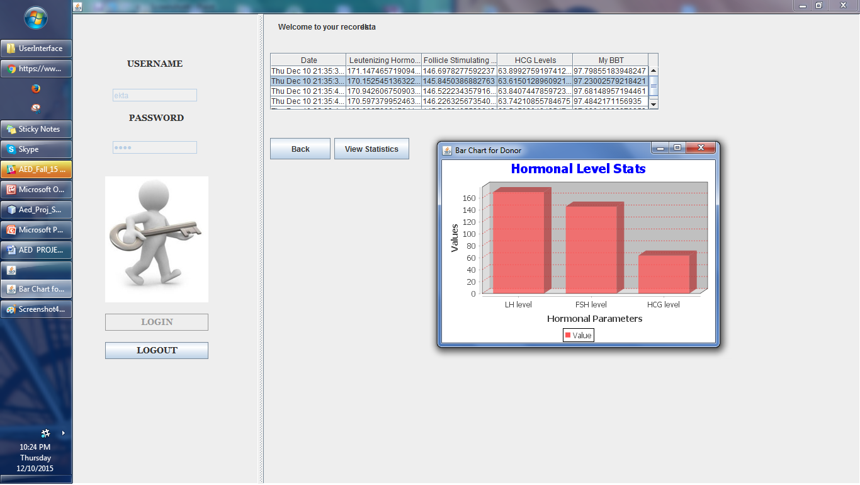
Patient views Stats from her Iot device

Slide 11
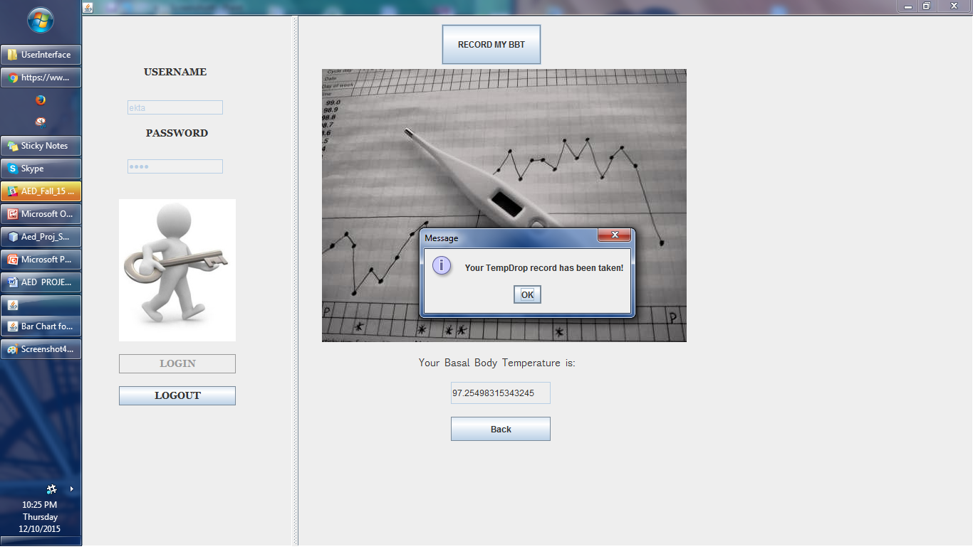
Donor/Recipient records Temp on her IoT device

Slide 12
Conclusion
An implementable application has been achieved for Global Egg Donation System using IoT device

